Slide 1

A PROJECT ON
A PROJECT ON
RECOMMENDATION OF PRODUCTS BASED ON
CUSTOMER’S REVIEW

Slide 2

in partial fulfillment of the requirements for the award of
MASTER OF SCIENCE IN STATISTICS
DEPARTMENT OF STATISTICS
UNIVERSITY COLLEGE OF SCIENCE
OSMANIA UNIVERSITY HYDERABAD – INDIA
By
M.PRATHIMA Roll No:1007-17-507-041
S.SHRAVANI Roll No:1007-17-507-017
M.LIKITHA Roll No:1007-17-507-034
P.MADHURI Roll No:1007-17-507-016
P.LAVANYA Roll No:1007-17-507-042
B.MADHAN MOHAN Roll No:1007-17-507-033
M.RAMESH Roll No:1007-17-507-022
MOHAMMED KADHIM Roll No:1007-17-507-044
SHANSHOOL
Under the Supervision of
Dr. M. VENUGOPALA RAO

Slide 3

Text mining
Text mining is a process of exploring and analyzing large amount of unstructured text data aided by software that can identify concepts, patterns, topics, keywords and other attributes in the data .
Text mining is similar in nature to data mining, but with a focus on text instead of more structured forms of data. However, one of the first steps in the text mining process is to organize and structure the data in some fashion so it can be subjected to both qualitative and quantitative analysis.
Doing so typically involves the use of natural language processing (NLP) technology, which applies computational linguistics principles to parse and interpret data sets.

Slide 4
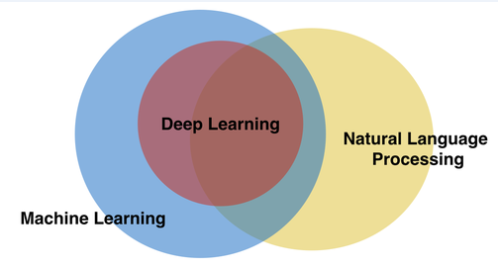
NATURAL LANGUAGE PROCESSING
Natural Language Processing(NLP)is ability of a computer program to understand human language as it is spoken. NLP is a component of Artificial Intelligence(AI)

Slide 5
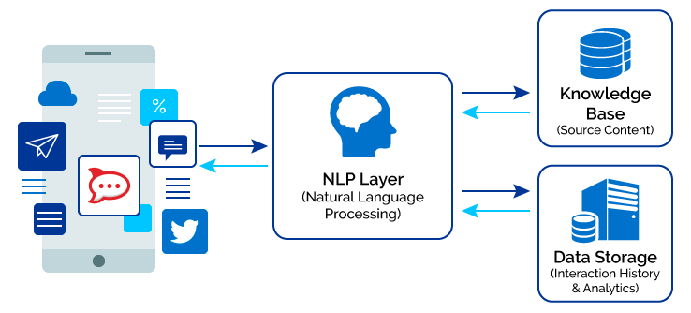

Slide 6

APPLICATIONS OF NLP:

Slide 7
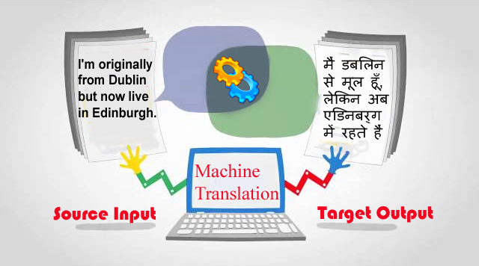
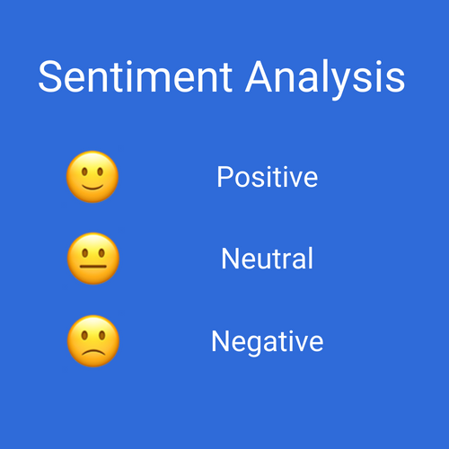
Machine Translation: it is process by which computer software is used to transulate a text from one natural language to another.
Sentiment Analysis: sentiment analysis is also known as opnion mining is a field within NLP that builds systems that try to identify and extract opnion within text.

Slide 8
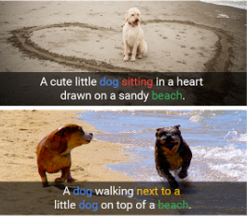
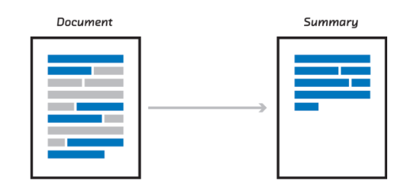
Image Captioning: this is the process of generating textual description of an image .it uses both NLP and computer vision to generate the captions.
Automatic Summarization: it is the process of shortening a text document with software,in order to create a summary with the major points of the original documents.

Slide 9
Scope of the problem:
This problem is related to Women’s Clothing E-Commerce reviews written by customers.
An algorithm, by which we recommend a product based on customer’s review.
SOURCE:
We have extracted the data from the website“www.kaggle.com”

Slide 10
Description of Data:
This is a Women’s Clothing E-Commerce dataset revolving around the reviews written by customers.
Format: This dataset includes 23486 rows and 10 feature variables. Each row corresponds to a customer review and includes the variables as follows.
Clothing ID: Integer Categorical variable that refers to a specific piece being reviewed.
Age: Positive integer variable of the reviewers’ age.
Title: String variable for the title of the review.

Slide 11
Review Text: String variable for the review body.
Rating: Positive ordinal integer variable for the product score granted by the customer from 1 to 5.
Recommended IND: Binary variable stating where the customer recommends the product where 1 is recommended, 0 is not recommended.
Positive Feedback Count: Positive integer documenting the number of other customers who found this review positive.
Division Name: Categorical name of the product high level division.
Department Name: Categorical name of the product department name.
Class Name: Categorical name of the product class name.

Slide 12
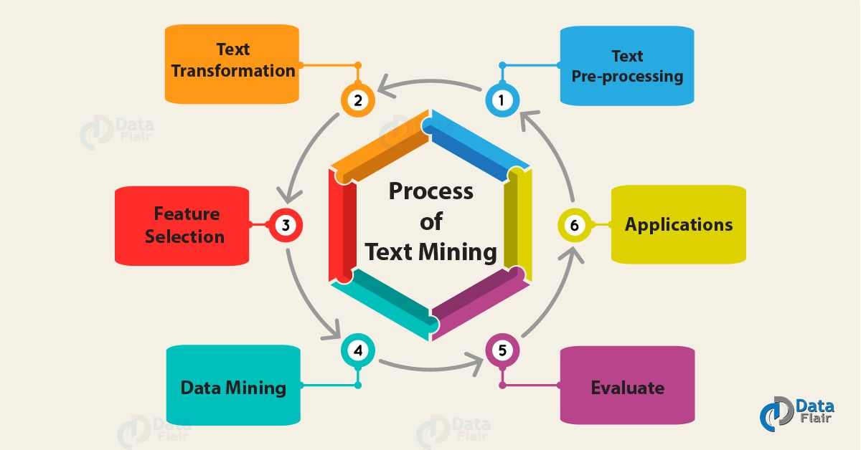
STANDARD NLP WORKFLOW

Slide 13

TEXT PRE-PROCESSING

Slide 14
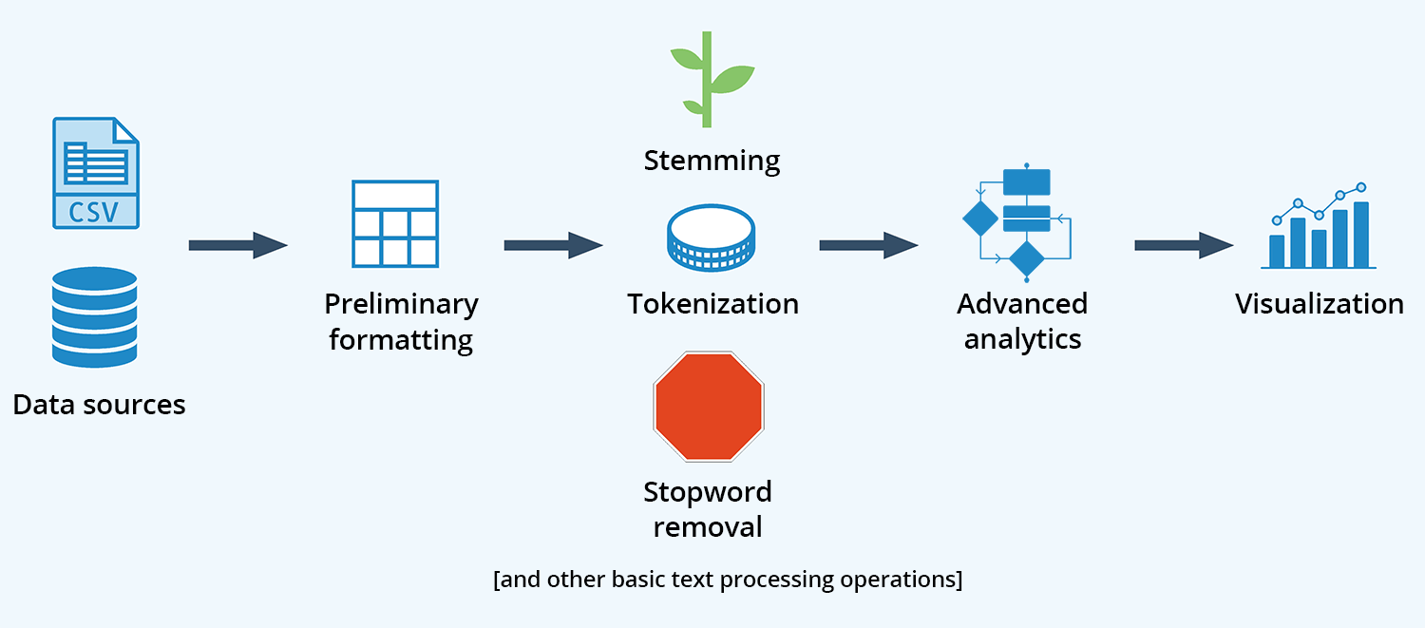

Slide 15
Text Mining at work
Remove punctuation:
[1] i had such high hopes for this dress and really wanted it to work for me i initially ordered the petite small my usual size but i found this to be outrageously small so small in fact that i could not zip it up i reordered it in petite medium which was just ok overall the top half was comfortable and fit nicely but the bottom half had a very tight under layer and several somewhat cheap net over layers imo a major design flaw was the net over layer sewn directly into the zipper it c
[2] i love tracy reese dresses but this one is not for the very petite i am just under 5 feet tall and usually wear a 0p in this brand this dress was very pretty out of the package but its a lot of dress the skirt is long and very full

Slide 16
Remove stopwords and Specified stopwords:
[1] high hopes really wanted work initially ordered petite small usual size found outrageously small small fact zip reordered petite medium ok overall top half comfortable fit nicely bottom half tight layer several somewhat cheap net layers imo major design flaw net layer sewn directly zipper
[2] love tracy reese dresses one petite 5 feet tall usually wear 0p brand pretty package lot skirt long full overwhelmed small frame stranger alterations shortening narrowing skirt take away embellishment garment love color idea style work returned
Stemming the document:
[1] high hope realli want work initi order petit small usual size found outrag small small fact zip reorder petit medium ok overal top half comfort fit nice bottom half tight layer sever somewhat cheap net layer imo major design flaw net layer sewn direct zipper c
[2] love traci rees dress one petit 5 feet tall usual wear 0p brand pretti packag lot skirt long full overwhelm small frame stranger alter shorten narrow skirt take away embellish garment love color idea style work return [3] run small esp zipper area run order sp typic fit tight materi top look feel cheap even pull

Slide 17
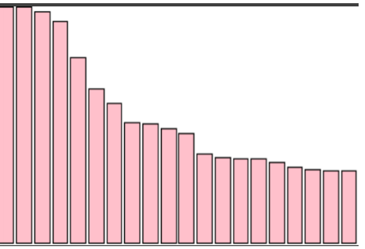
FEATURE EXTRACTION
Term Document Matrix: Dimension [3799 1773]
Document TermMatrix : Dimension [1773 3799]
Viewing the top 10 most common words:
fit look size love top wear color fabric order small 831 815 779 652 542 492 423 419 402 834

Slide 18
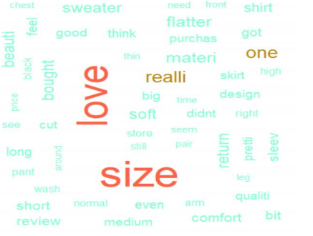
Word Cloud:

Slide 19
Tokenization:
UNIGRAM:
"high" "hope" "realli" "want" "work" "initi" "order" "petit" "small" "usual" "size" "found" "outrag" "small" "small" "fact" "zip" "reorder" [19] "petit" "medium" "just" "ok" "overal" "top" "half" "comfort" "fit" "nice" "bottom" "half" "tight" "layer" "sever" "somewhat" "cheap" "net" "layer" "imo" "major" "design"
BIGRAM:
"flaw" "net" "layer" "sewn" "direct" "zipper" "c" "high_hope" [49] "hope_realli“ "realli_want" "want_work" "work_initi" "initi_order" "order_petit" "petit_small"

Slide 20

FEATURE ENGINEERING

Slide 21
Creating a bag of words:
Dimension [1773 35828]
Removing sparsity : Here we omitted the 70% of sparse data
Creating the Data frame Matrix:
Here we are considering data with 30% sparsity and the dimension of that matrix is [1773 288]
Names:
"document" "high" "hope" "realli" "want" "work" "order" "petit" "small" "usual" "size" "found" "medium" "just" "overal" "top" "comfort" "fit" "nice" "bottom" "tight" "definit" "layer" "cheap" "design" "zipper" "style" "felt" "bit" "boxi" "typic" "run" "love" "print" "qualiti" "though" "recommend" "realli_want" "usual_size" "dress" "one" "tall" "wear" "pretti" "lot" "skirt" "long" "full“ "take" "color" "return" "usual_wear" "love_color" "area" "materi"

Slide 22
Structure:
Structure of the matrix after binding with dependent variable: 'data.frame': 1773 obs. of 289 variables:
$ recommand : Factor w/ 2 levels "0","1": 1 1 1 1 1 1 1 1 1 1 ...
$ high : int 1 0 0 0 0 0 0 0 0 0 ...
$ hope : int 1 0 0 0 0 0 0 0 0 0 ...
$ realli : int 1 0 0 0 1 0 0 0 0 0 ...
$ want : int 1 0 0 0 0 0 0 0 0 0 ...
$ work : int 1 1 0 0 0 0 0 0 0 1 ...
$ order : int 1 0 1 0 0 0 2 0 0 0 ...
$ petit : int 2 1 0 0 0 0 0 0 0 0 ...
$ small : int 3 1 1 0 0 0 0 0 0 1 ...
$ usual : int 1 1 0 0 1 0 0 0 0 0 ...
$ size : int 1 0 0 0 0 1 0 0 0 0 ...
$ found : int 1 0 0 0 0 0 0 0 0 0 ...
$ medium : int 1 0 0 0 1 0 0 0 0 0 ...
Etc………………

Slide 23


Slide 24
Splitting the data into Train and Test data:
Dimension of Train Data:
[1241 289]
Dimension of Test Data:
[532 289]

Slide 25
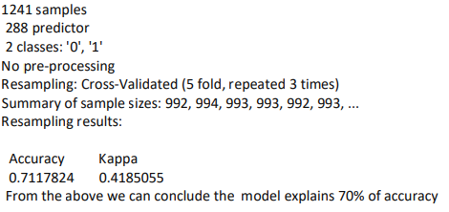
Running pipeline using K-Fold Cross Validation:
Run algorithms using 5-fold cross validation
1.Logistic Regression Model:
set.seed(1346)
fit.glm = train(recommand~., data=train, method="glm", metric="Accuracy", trControl=control)
print(fit.glm)

Slide 26
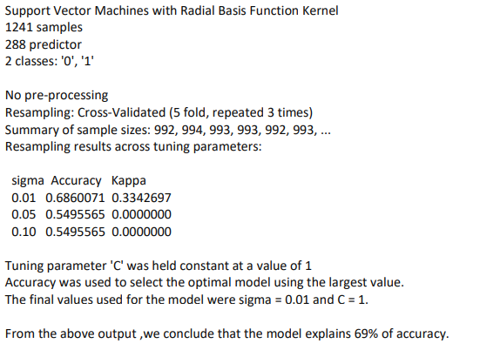
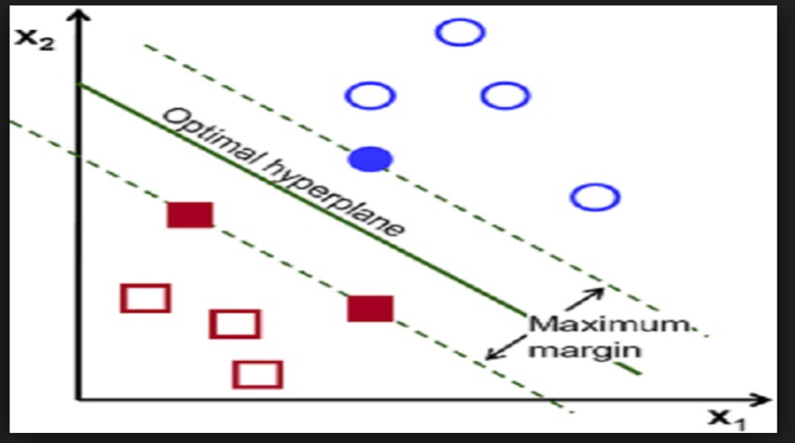
2. Support Vector Machine:
set.seed(1346)
grid = expand.grid(.sigma=c(0.01,0.05,0.1), .C=c(1))
fit.svm = train(recommand~., data=train, method="svmRadial", metric="Accuracy", tuneGrid=grid, trControl=control)
print(fit.svm)

Slide 27
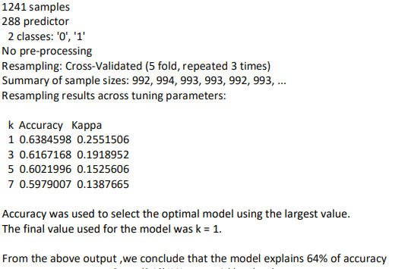
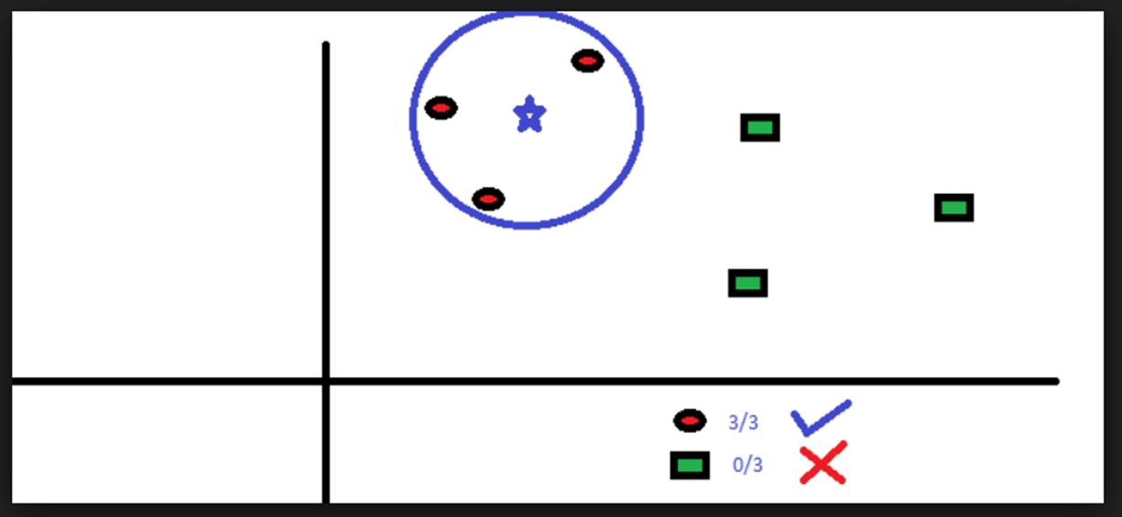
3.K-Nearest Neighbourhood:
set.seed(1346)
grid = expand.grid(.k=c(1,3,5,7))
fit.knn = train(recommand~., data=train, method="knn", metric="Accuracy", tuneGrid=grid, trControl=control)
print(fit.knn)

Slide 28
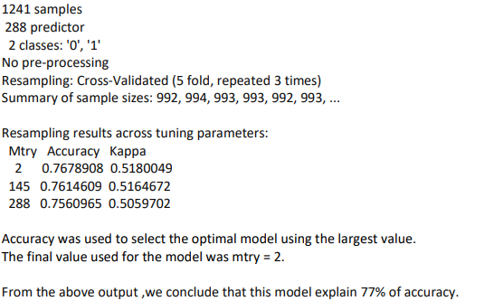
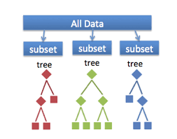
4. Random Forest:
set.seed(1346)
fit.rf = train(recommand~., data=train, method="rf", metric="Accuracy", trControl=control)
print(fit.rf)

Slide 29
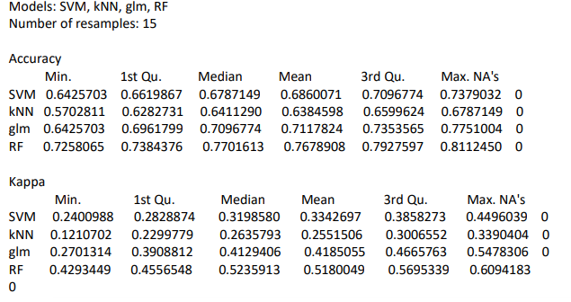
Comparing Algorithms:

Slide 30
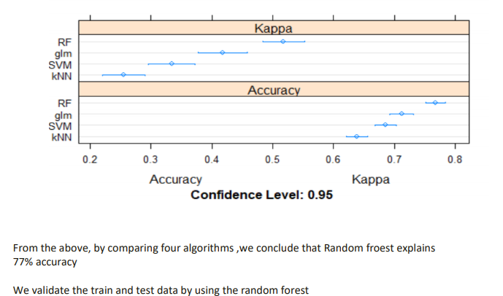
Dotplot:

Slide 31

VALIDATION

Slide 32
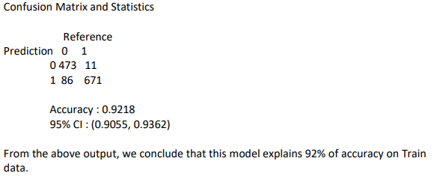
Validation of Train data:

Slide 33
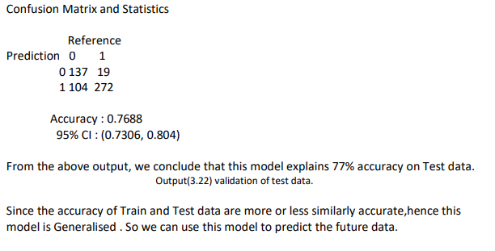
Validation of test data:

Slide 34
CONCLUSION
Since the accuracy of train and test data are more or less similar , we conclude the the model is generalised model .
So this obtained generalised model can be applied for any un seen data reviews for recommandation .

Slide 35
THANK YOU!

